Slide 1
Dean Trust Rose Bridge Pupil Parliament
Head of School, 2x Representatives from each Year Group (Pupil Executives)
Head Boy & Head Girl
Events
Committee
Pastoral
Committee
Learning
Committee
Environment
Committee
Inclusion
Committee
Senior Prefects
3 x Representatives from each Year Council (7-10)
3 x Representatives from each Year Council (7-10)
3 x Representatives from each Year Council (7-10)
3 x Representatives from each Year Council (7-10)
3 x Representatives from each Year Council (7-10)
Prefects
Year 7 Year Council
Year 8 Year Council
Year 9 Year Council
Year 10 Year council

Slide 2
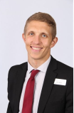
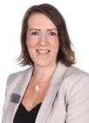
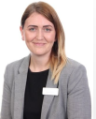
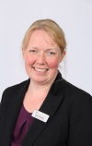
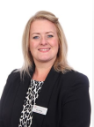
Committees
Events Committee
Pastoral Committee
Learning Committee
Environment Committee
Inclusion Committee
Standards and expectations
Anti-bullying
House System/Events
Well-being support
Rewards
Improving Teaching & Learning across the school
Careers Ambassadors
KS4 Study Support
Newsletter
Whole-school events
Incl. Sports Day, Awards Evening, Parents’ Evenings, Open Events.
Primary Liaison
Charity outreach
Enrichment
Eco ambassadors
Healthy Eating Campaigns
School Site Improvement
Litter initiatives
Visitor Liaison
DoE
Jamboree Day
Debate Team
Inclusivity Ambassadors (LGBTQ+)
Reading Mentors
SEND Support

Slide 3
Job description
Form Representative
Person specification
Act as an Ambassador for the DTRB Community
Lead by example in all aspects of school life
Attend House or year group meetings as requested
Represent your form in school initiatives and events
Lead on Pupil Voice in your form
Offer support to all members of Pupil Parliament
Excellent attendance, behaviour and punctuality
Well organised
Engaged in enrichment activities
Good relationships with staff and peers
Ability to work as a team
Empathetic and supportive of others

