Slide 1
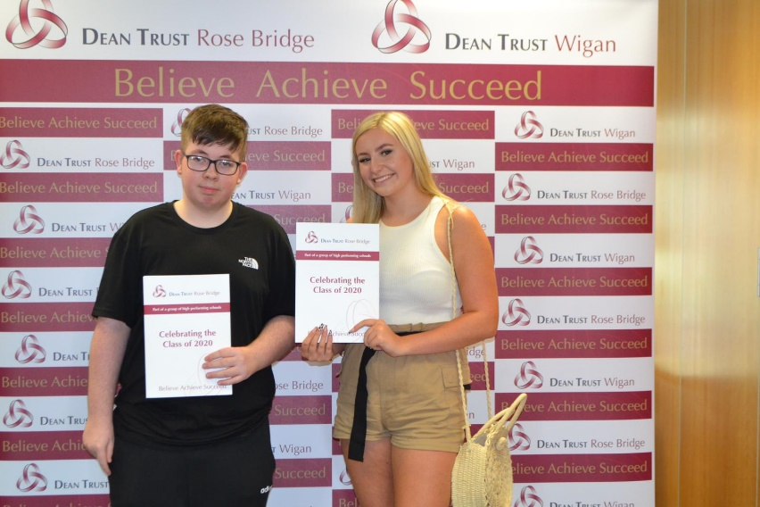
Welcome back and a warm welcome to our new pupils. In the past few weeks there has been a great deal of activity behind-the-scenes, preparing for the return of our pupils. Getting children back to school is so important, they have missed so much already socially emotionally and academically. Whilst a return to normal for all our pupils would be our ambition, we need to ensure that we do so safely and following government guidance.
We are determined to improve our school and create a school that the community is proud of. That is what parents/carers, quite rightly, expect. We have taken time this week to discuss our 3 Musts with pupils. These musts are our 3 expectations of pupils. These basic expectations will help learning and catch up take place and of course help us to make our school great.
J Haseldine
Executive Headteacher
Class of 2020
Our Class of 2020 received their GCSE grades on the 20th August - this cohort faced challenges that no other year group in memory have faced and we are immensely proud of them. The grades awarded by their teachers are a fair and accurate reflection of how we feel they would have performed if they had been allowed to sit their exams in the summer and it was a pleasure watching their faces as they opened their envelopes. We wish them all the best in the next stage of their lives and their education.

Slide 2
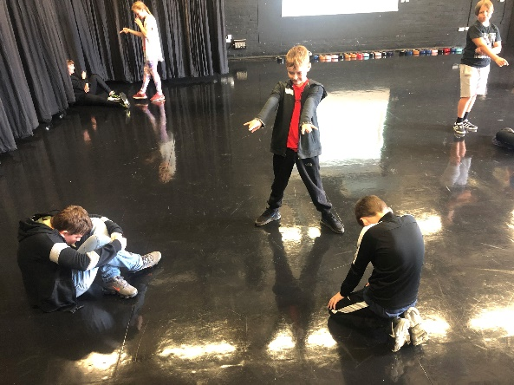
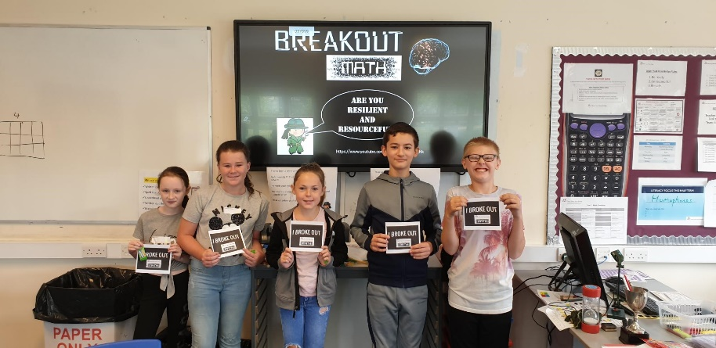
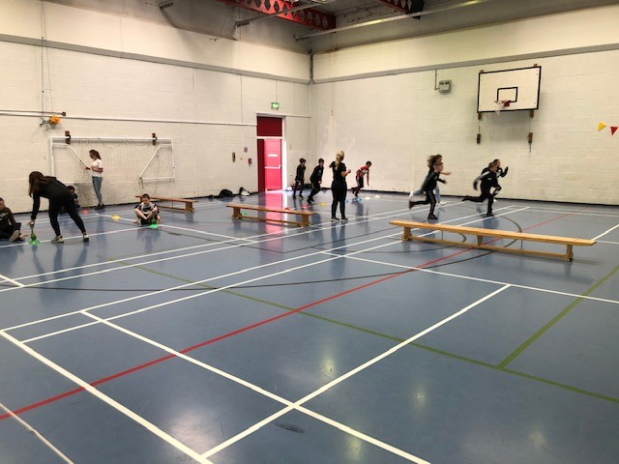
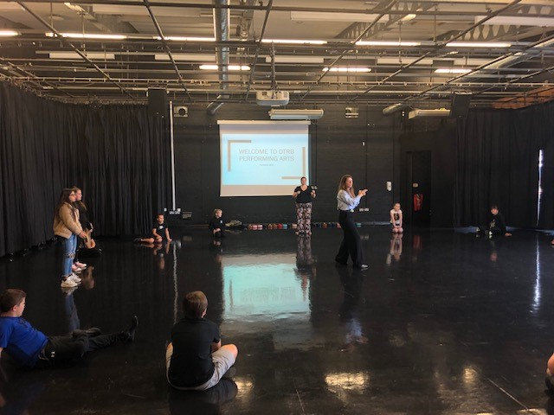
Welcome Year 7!
Before the Summer break, a team of intrepid teachers ventured over Manchester Road to visit Ince CE Primary School, one of our bigger feeder schools, to deliver an afternoon of exciting and engaging taster sessions to their Year 6 cohort. Sessions varied from Matilda Masterclasses to Scientific explorations, as well as a journey through the Spanish vocabulary and into a troublesome teambuilding task. Pupils appeared to love the activities, and spending the afternoon over at Ince certainly helped those pupils coming to DTRB in September put some anxieties at bay and build some positive relationships with future teachers. A fantastic afternoon was had by all and made us all very excited to welcome those Year 6 pupils to DTRB as Year 7 pupils in September!
Over the Summer Holidays, our new Year 7 cohort were welcomed into school to see the school for themselves before starting with us as ‘official’ DTRB pupils. Just shy of 100 Year 6 pupils joined over three days for a series of activities and opportunities designed to reacquaint ourselves ith a school setting, meet some of the staff that will be teaching us in September, meet the other pupils in our teaching bubbles and to have a lot of fun along the way. But it wasn’t just pupils who got to come in and experience the school – parents were also invited in for a personal meeting with a member of the Senior Leadership Team or Year 7 Team so that any anxieties could be allayed and information shared between both parties. As well as certificates and awards, there were lots of smiles and laughter on show which made for a lovely atmosphere within the cohort. What a way to bring the summer holidays to a close and to begin their secondary school experience. A huge thank you to all staff and parents for working together to make this opportunity a possibility for our pupils.

Slide 3
Welcome Back from Ms McQueen and the English Department!
Welcome back DTRB students. We in the English department are really excited to get back to learning with you and have been working hard to make sure your lessons are as interesting, exciting and safe as possible. We know there’s going to be gaps in your knowledge and that it can be hard having been away for so long, but please don’t let that worry you. Everyone is in the same boat and we want to work with you to build up your confidence and claw back the lost learning. So what are you waiting for? Let’s get going!
Ultimate English Extravaganza!
Over the summer term a fantastic number of students took part in our 9 week ‘Ultimate English Extravaganza’!
We just wanted to say a huge congratulations to Amy Rouke who earnt herself 120 Praise Points and a £20 Amazon Voucher for completing the most tasks over the 9 weeks!
Thank you and well done to everyone who took part!
English Transition/Summer School
During the summer holidays, some of the department were lucky enough to meet some of our new year 7s in preparation for September. The classes that took part in the English lessons were amazing and produced fantastic quality creative writing based around their own design for a chocolate room as well as describing their favourite chocolate bar in Spanish! It was lovely to meet so many of
you and well done! We can’t wait
for your fabulous work to
continue this year!
Extra-Curricular!
In the English department, we will be offering a range of extra-curricular activities across the school which will be rotated on a half termly basis. At the end of each half term, each club will display their final projects in order to win a prize for their whole team! There will also be a chance to win prizes for attendance and engagement throughout the half term!
The clubs running this half term will be:
Y7 – Careers Club with Mr Hayes
Y7 – Reading Club with Mrs Kelly
Y8 – Creative Writing with Miss Jones
Y9 – Challenge Club with Miss Winrow
Y10 – Revision with Miss Tunnicliffe
Y11 – Revision with Ms McQueen
If you are interested in joining a club, please speak to your English teacher!
Careers – Competition!
What better way to start the academic year than by bagging yourself 20 Class Charts points? That’s what the winner of our Careers Poem Challenge will win. Simply
write a poem about a job that you would like to do when you’re older,
and submit it to your English teacher no later than 11th September.
Good luck!

Slide 4
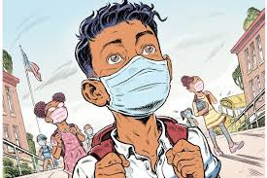
Book of the week: ‘The Haunting of Aveline Jones’ by Phil Hickes!
Aveline Jones loves reading ghost stories, so a dreary half-term becomes much
more exciting when she discovers a spooky old book. Not only are the stories
spine-tingling, but it once belonged to Primrose Penberthy, who vanished
mysteriously, never to be seen again. Intrigued, Aveline decides to investigate
Primrose's disappearance. Now someone...or something, is stirring. And it is
looking for Aveline.
Word of the Week!
Apprehensive adjective
Anxious or fearful that something bad or unpleasant will happen.
Challenge 1: Can you think of a time you have felt apprehensive about something? Who helped you to overcome it?
Challenge 2: What advice would you give to someone who was feeling apprehensive about something?
International Day of Literacy!
International Literacy Day is an annual celebration by UNESCO which is celebrated every 8th of September. Literacy Day is celebrated to show light on global literacy needs with mission literacy for everyone and everywhere.
How can you help this International Literacy Day? Why don’t you try collecting books for charity, starting a book club or giving a book as a gift!
GCSE Pod – Calling Y11 Students!
Please make sure you all have a GCSE Pod log when you return to school! There are a vast number of excellent revision resources, tests and example questions on the programme that will be used as homework, catch-up and individualised homework in the coming weeks. Make the most of this fantastic resource as and when you can!
Roald Dahl Day
Saturday 13th September is Roald Dahl Day celebrating one of the world’s greatest storytellers! Roald Dahl is one of the most famous British writers and is author to books such as Charlie and the Chocolate Factory, George’s Marvellous Medicine and Matilda! Why not celebrate the occasion by dressing up as your favourite Roald Dahl character, write a review of a Roald Dahl book or come up with a completely new character for one of his stories? Don’t forget to share your creations with us!
Library Books
A lot of pupils have books at home which they haven’t been able to return, however, now we are back in school, that is possible. They can’t be delivered in person, but I would ask pupils to place them in the assigned box or area in the classroom, so that they can be collected and returned to the shelves.
So it’s time to start looking under the bed, in your old schoolbag, behind the dog’s basket, under the wobbly chair leg or anywhere else they might be, and let’s see if we can get them all back by the end of next week!

