Slide 1
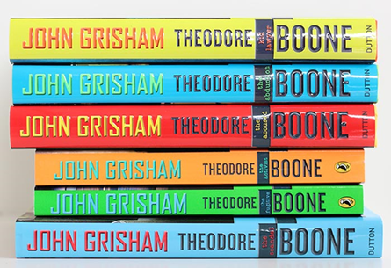
Friday 6th March 2020
World Book Day was a sight to behold at Dean Trust Rose Bridge. Thanks to pupils for taking part in the plethora of events that took place. Staff took the event very seriously and dressed up for the occasion as characters from their favourite books.
This week the focus has been on ‘National Careers Week’ and as you will see from the Newsletter, a great deal of activities and visits from external employers have taken place.
We have an outward bound expedition taking place this weekend. The weather has much improved so pupils are in for a great time in the Lake District. Thanks go to staff for giving their time to do this. In addition, our planned events for examination preparation begin in earnest this weekend with Saturday ‘Extra’ tuition seminars. All Year 11s will also be invited to a daily free breakfast in the small sports hall from a week on Monday for breakfast seminars on a rolling programme of subjects. We have purchased revision cards for all Y11 pupils this year and invested in GCSE POD for on line independent revision through short clips and videos. I hope this is well used by pupils.
Parent Forum Event
On Wednesday 12th February, we held our first Parent Forum Event. Thank you to all parents/carers who came along. Following your feedback, we wanted to share with you a range of actions that have taken place since the event. These include…
- Changing school policy so that all texts sent via SchoolGateway are now acknowledged.
- For any letter that is sent home with a pupil, a text message is also sent out. - Personalised voicemails for all Heads of Year and Pupil Support Managers and supportive functions added.
We welcome all feedback offered to us by members of community and hope these changes help to make a substantive difference to your experience. Our next Parent Forum Event is Thursday 18th June and we hope to see you there.
Book of the week
This week’s suggestion is from Nathan Aspinall in Year 9, who has been reading the ‘Theodore Boone’ series, by John Grisham.
I’ve read the first two books and I’m now on the third. I really enjoy reading these books because they have just the right amount of action and have me on the edge of my seat.
The stories are set in a courtroom, where the young hero, Theodore Boone has to get to the truth to prove his clients’ innocence.
In my opinion these are the best mystery books around! No-one does legal fiction better!

Slide 2
Sponsored Read!
We celebrated and encouraged a lifelong love of books and reading this week and ran a SPONSORED READ between Monday 2nd March and Friday 6th March. All Pupils in Key Stage 3 were given a sponsor form and it was fantastic to see so many taking part.
The project was organised in conjunction with our Usborne Organiser, Christina Taylor, and all the money raised will go towards brand new books for our school.
In addition to the sponsorship money, Usborne have also agreed to donate up to 60% of the total raised in EXTRA FREE BOOKS to the school. So for every £600 raised, we will get an extra £360 in FREE Usborne books!
Please help us to enhance our reading resources for Pupils by encouraging them to read at home. And it’s not just books that can be enjoyed: comics, magazines, recipes, menus, your favourite websites - anything with words that they can read counts towards their total!
Can you please send all sponsorship money that your child has raised to the school by Friday 13th March 2020.
We look forward to having lots more books for your child to read, look at, share and enjoy.
Parent and Pupil Apprenticeship Presentation
It was amazing to welcome so many parents/carers into school on Monday to take part in our Apprenticeship session. The topics discussed were:
How do apprenticeships work?
How to search for vacancies.
Keep a look out on our twitter page and the careers section of our website for more upcoming parent and pupil events.
If there is a careers event you think we should run, please get in touch with Mrs Norburn or Mrs Gibbard.

Slide 3
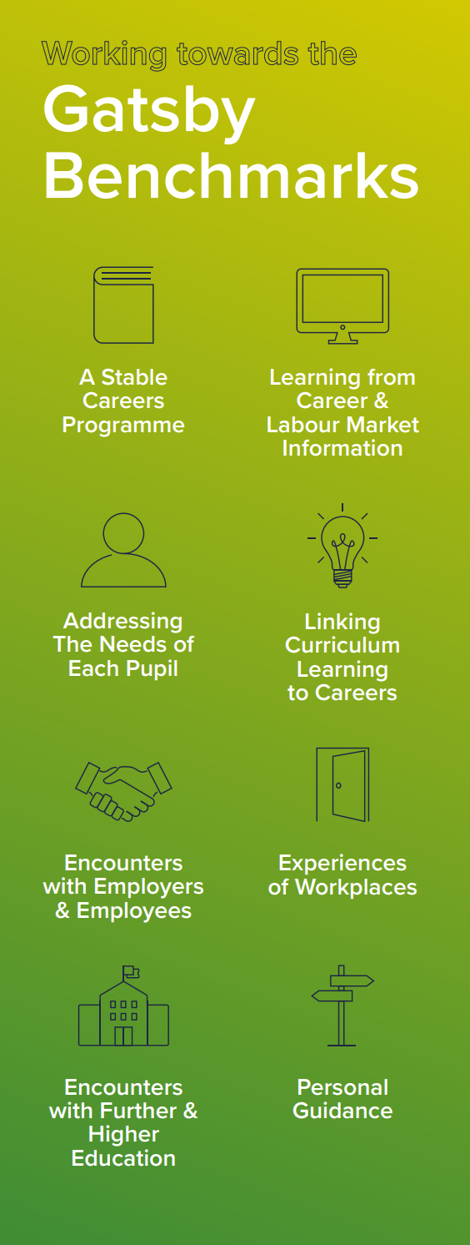
Careers Cafés
There were a range of opportunities this week for our pupils to engage with employers from a variety of sectors.
Monday
The Headteacher from a local primary school (Cannon Sharples) visited during lunch with a female engineer, who is currently completing her degree apprenticeship with thby77e company ABB to describe their careers to pupils. There were some fantastic questions from pupils – we needed more time, there were so many.
.

Slide 4
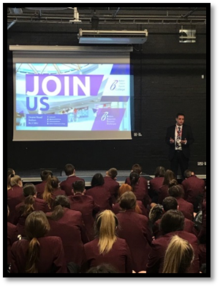
Careers Assemblies
There were a range of opportunities this week for our pupils to listen to guest speakers from a range of FE providers and employers.
Monday
we welcome Charlie from Camps International who informed pupils in Year 9, 10 and 11 about an amazing opportunity to join them on a 4-week expedition to Cambodia during the summer of 2021 to work on meaningful sustainable community and conservation projects. All pupils received a letter with more details and an invitation for parents/cares to attend an information evening on 12th March, meet at the main hall at 6:30pm
Tuesday
Alliance learning visited to provide pupils with information about apprenticeship opportunities
Tuesday also saw Bolton Sixth form continue with your Y10 college assemblies to inform them about their courses and other opportunities.. Many other colleges have already visited and we have many more to come.
Picture needed for here

Slide 5
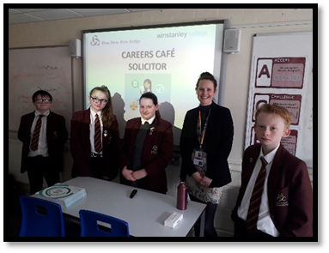
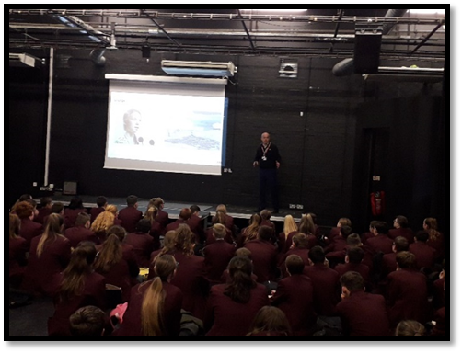
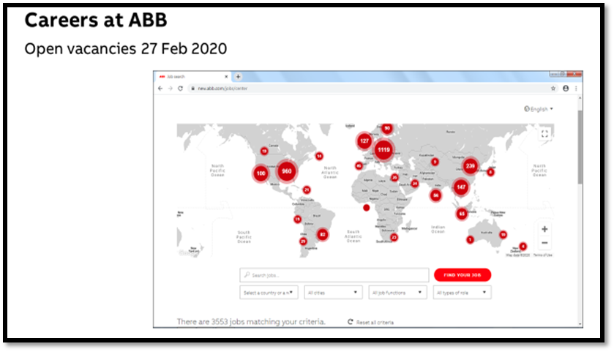
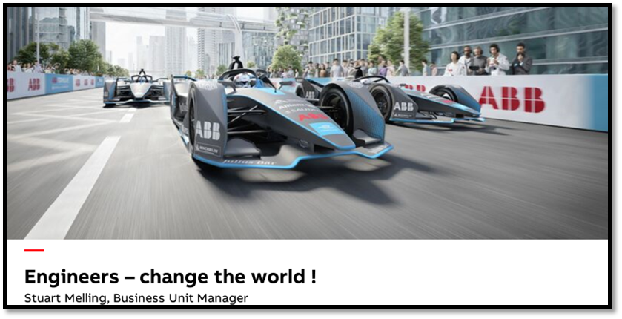
Wednesday
Careers Week continued with an assembly from Stuart Melling, Business Manager and former engineer for ABB, a global engineering company who currently sponsor E-formula 1.
Pupils from both Year 8 and 9 were able to find out about the engineering industry, Stuart’s own career path, salaries, employability and also degree apprenticeships available. Our visitor commented on the superb behaviour of pupils – well done to all pupils involved.
Also on Wednesday a solicitor visited school on Wednesday to talk to our future lawyers about different types of law and pathways to law-related careers.
Wednesday’s Careers Week continued with an assembly from Stuart Melling, Business Manager and former engineer for ABB, a global engineering company who currently sponsor E-formula 1.
Pupils from both Year 8 and 9 were able to find out about the engineering industry, Stuart’s own career path, salaries, employability and also degree apprenticeships available. Our visitor commented on the superb behaviour of pupils – well done to all pupils involved

Slide 6
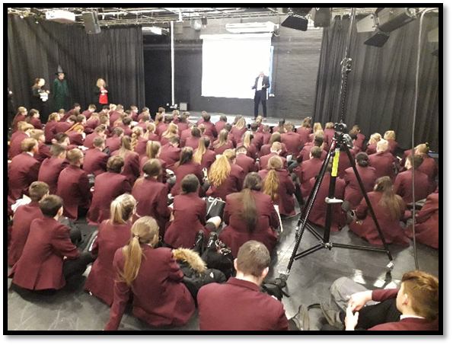
Friday Careers Café was run by Riverside Housing Association who offer energy, employment and other advice to tenants to help improve living standards.
Thursday
As we moved towards the end of National Careers Week, we kicked off Thursday with an assembly for both Y10 and 7 delivered by David Roden, Director of Nuclear Fuel from Sellafield. David is a former pupil of Rose Bridge, so it was a great opportunity for pupils to see the success of a former pupil and learn about opportunities. David emphasised the need to work hard to get the best qualifications they can.
Friday
Matthew Trellfall, a Fibro Electric Business owner, visit to speak with Y10 pupils. Matthew discussed his own career-path and challenges he faces with owning his own business.

Slide 7
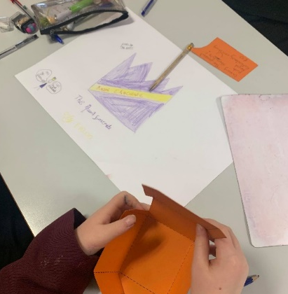
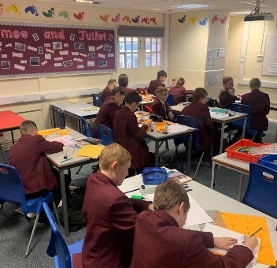
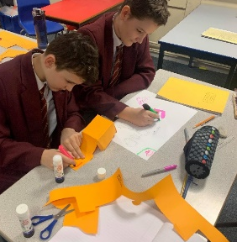
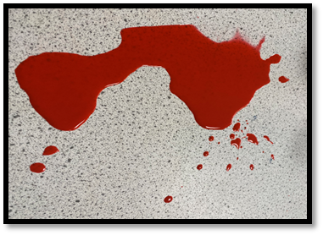
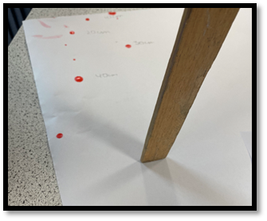
Curriculum to Careers English
To mark National Careers Week subject areas have delivered dedicated careers lessons to Year 7, 8 and 9 to share how their subject links to the world of work.
Year 7 pupils entered the world of work in English this week, when they created and marketed a new chocolate bar. Their finished marketing product will include a 3D advert which will
be displayed in school.
Curriculum to Careers Science
We started our careers lesson this week with a true or false recall 5 about our chosen career – Bloodstain pattern analyst.
Recall 5 (True or false)
Bloodstain pattern analysts examine blood that is left behind at crime scenes in whatever quantity. It can be a trace amount in the form of a trail or a print, or it can involve a large volume of blood – or any amount in between.
Aspiring blood spatter analysts will find that note-taking, photography, and sketching skills will all be beneficial to the training process.
Many bloodstain pattern analysts have prior law enforcement experience.
Bloodstain analysis requires a meticulous and thorough understanding of the properties of blood and the human body. Anatomy plays a large role as it pertains to arterial flow and the behaviour of blood before and after it leaves the body.
Once hired, blood spatter analysts attend classes and workshops to continually update their skills and knowledge.
We the went on to investigate how the diameter of a blood drop changes with the height it is dropped from.

Slide 8
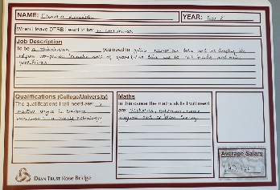
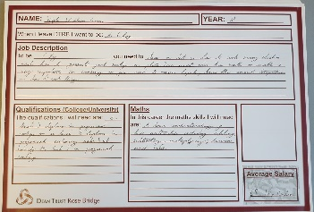
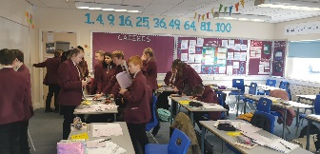
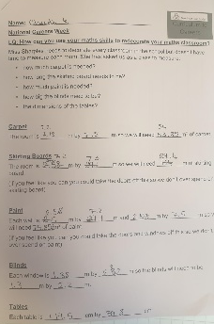
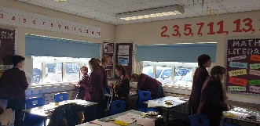
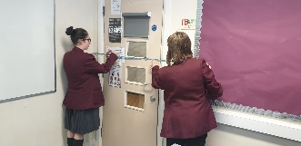
Curriculum to Careers Maths
Homework and Recall 5
All pupils in years 7, 8, 9, and 10 completed a careers homework on a career of their choice. All pupils completed this homework fantastically and some of the most detailed homework's were selected to display around the school. Pupils really enjoyed researching a career that interests them and learning about what the job entails (some of them even taught us!).
Careers Lesson:
To celebrate careers week, Year 8 completed a careers lesson where they measured their maths classroom for redecoration.
Careers Lanyards:
Each member of the Maths department now wears a card on their lanyard that displays 5 Maths careers and 5 words associated with careers and Maths. These have promoted discussions around Maths in everyday life and how important Mathis is in every career.

Slide 9
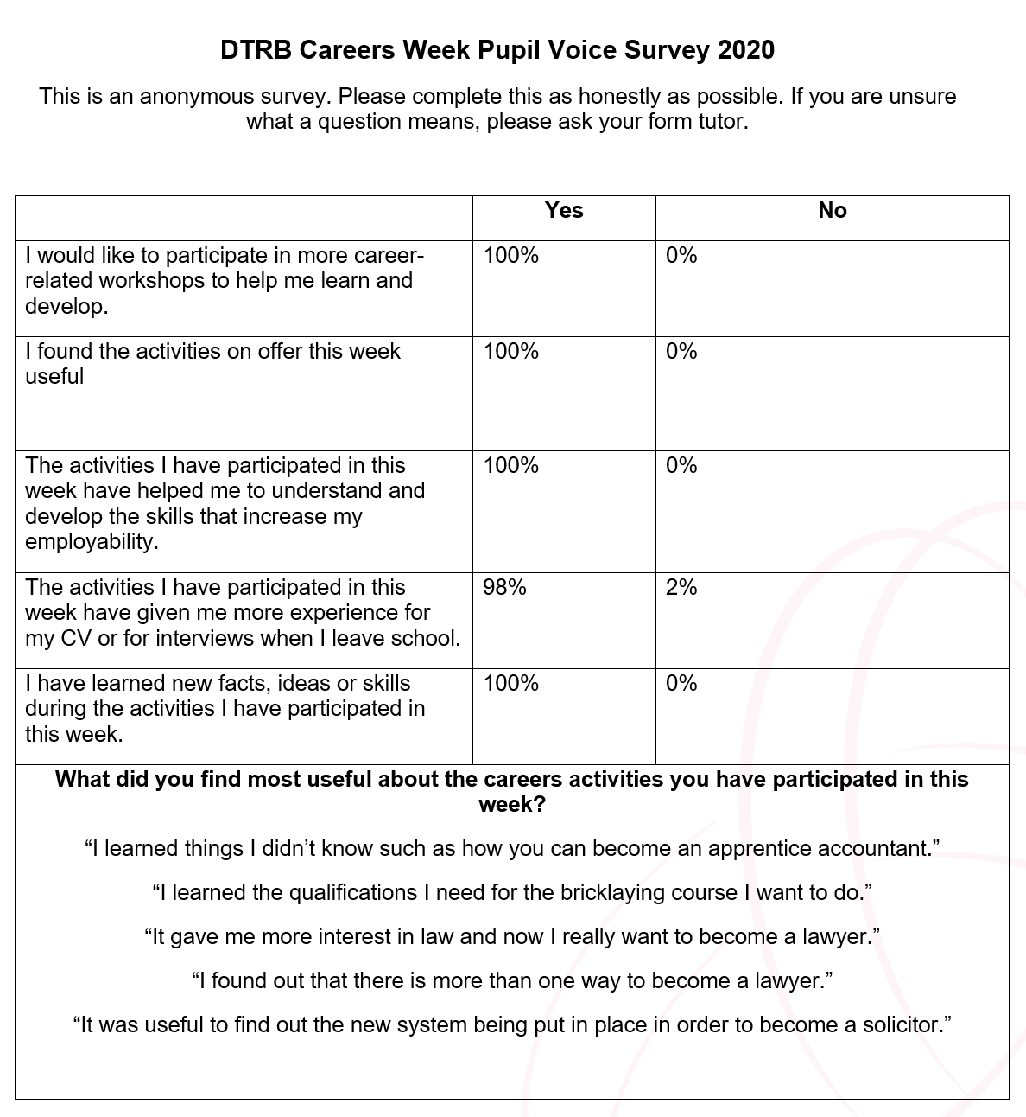
Our careers provision is constantly growing and evolving. As part of this process we ask for pupil feedback after all of our events to ensure what we are delivering is useful for our pupils. To help us do this, our Year 7 pupils have spent the week setting up their Start profiles and completing their personality profiles to make sure we are tailoring our provision to meet their needs and interests.

